Slide 1
Team Communications Taking Charge of your day through PRe-Shift Meetings
Provided by the LAUSD Food Services Division

Slide 2
Benefits of Holding Pre-Shift Meetings
Promotes Consistency
Creates
Teamwork
Motivates Employees
Notes:
TELL: There are many benefits to conducting Pre-shift meetings. A few are:
They promote consistencies as all employees hear the same information.
It creates teamwork whereas your staff has a goal that may require them to work together to get the job done.
It generates motivation for the employees to get the job done efficiently. Your employees should be stakeholders of the cafeteria operations and should be communicated as to changes to the operation and any updates to the programs.
INSTRUCTOR: (If needed) Define stakeholder - a person or group with a direct interest, involvement, or investment in something,

Slide 3
What Is A Pre-Shift Meeting?
A Pre-Shift Meeting is a short meeting that is held at the start of each work shift
It is used to communicate information to the staff
It is a vital tool to ensure the entire team is aware of what is happening in your cafeteria environment
How Often Should You Hold Pre-Shift Meetings?
Pre-Shift meetings should be an integral part of your daily operations and part of your communication strategy
Pre-shift meetings are held twice a day
Morning team members
Afternoon team members

Slide 4
What Is Discussed In A Pre-Shift Meeting?
A pre-shift meeting entails pertinent information staff members need to know for a successful operational day.
Promotes Consistency
Daily operational goals
Relay important updates
Creates Teamwork
Coach and train staff
Motivates Employees
Provide positive feedback
Get the team excited for the upcoming shift
When preparing the day’s pre-shift message, review the previous day’s information, repeat any important messages from the previous days.

Slide 5
Pre-Shift Meeting Delivery
The pre-shift meeting should be a joint-partnership between all members of the team.
Meetings are delivered in a positive, upbeat tone by:
SENIOR WORKER
WORKER
MANAGER

Slide 6
Pre-Shift Meeting Contents
OPERATIONS
Menu, OVS, Substituted items
Communicate any changes or specific dated items to use
Reimbursable meals
Efforts made to increase meal participation
DAILY FORECAST
Special/ Upcoming Events
Field Trips, Pep Rallies, Spirit Days
Weather
Rain increases opportunity; children unable to use playground area
TRAINING
Safety Highlights
Review monthly safety trainings; reiterate safety protocols
Policies & Procedures
Opportunity to review current or enhancements to policies/ procedures
INSPIRATION
Motivate Staff
Emote empathy and belief in team; “I believe we can reduce waste today”
Provide Positive Feedback
Be specific; “Great job team increasing 3% participation”
Thank Individuals
Acknowledge team members for specific recognition
Reinforce Trainings
Manager to provide in-house training
Holidays & School breaks
Adjusting meal counts; leading up to and include holiday & breaks
New Items
Provide samples to cafeteria staff
Notes:
TELL: There are four general areas in your pre-shift meetings that you should discuss during the course of the week; operations, forecasting, training and inspirations.
This is a great opportunity to discuss forecasting with any outliers for the day. You can discuss the day’s menu, what items need to be offered or taken to create a reimbursable meal, changes to the pricing if applicable, any item substitutions to the menu or take about the exciting new items on the menu. Correspond to your staff of any special events that could affect your operations, such as field trips, holiday, parties, and student testing. Also confer with them on how to precede their task for the day, thus creating teamwork for all. Training should be the primary focus of your pre-shift meetings. Use these minutes to reinforce training, review pertinent policies and procedures or reinforce safety measures.
It is just as important to uplift your employees with some inspiration, especially when the week has been challenging. Point out any positive actions that you and your staff have noticed. Keep your staff motivated and encourage them to stay positive. It is essential to end your meeting on a high note and share any positive happenings amongst the employees.

Slide 7
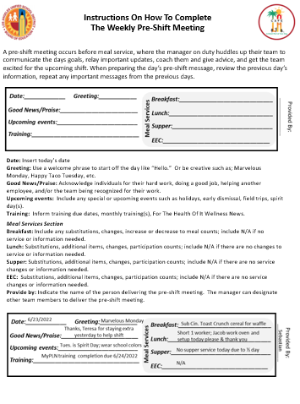
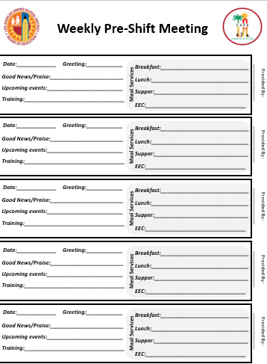
Pre-Shift Meeting Instructions
Notes:
TELL: There are many benefits to conducting Pre-shift meetings. A few are:
They promote consistencies as all employees hear the same information.
It creates teamwork whereas your staff has a goal that may require them to work together to get the job done.
It generates motivation for the employees to get the job done efficiently. Your employees should be stakeholders of the cafeteria operations and should be communicated as to changes to the operation and any updates to the programs.
INSTRUCTOR: (If needed) Define stakeholder - a person or group with a direct interest, involvement, or investment in something,

Slide 8
Completing The Weekly Pre-Shift Meeting
Date: Insert today’s date
Greeting: Use a welcome phrase to start off the day like “Hello.” Or be creative such as; Marvelous Monday, Happy Taco Tuesday, etc.
Good News/Praise: Acknowledge individuals for their hard work, doing a good job, helping another employee, and/or the team being recognized for their work.
Upcoming events: Include any special or upcoming events such as holidays, early dismissal, field trips, spirit day(s).
Training: Inform training due dates, monthly training(s), For The Health Of It Wellness News.
6/23/2022
Marvelous Monday
Thanks, Teresa for staying extra yesterday to help shift
Tues. is Spirit Day; wear school colors
MyPLN training completion due 6/24/22

Slide 9
Completing The Meal Services section Weekly Pre-Shift Meeting
Meal Services Section
Breakfast, Lunch, Supper, EEC: Include any substitutions, changes, increase or decrease to meal counts; include N/A if no service or information needed.
Provide by: Indicate the name of the person delivering the pre-shift meeting. The manager can designate other team members to deliver the pre-shift meeting.
Sub Cin. Toast Crunch cereal for waffle
Short 1 worker; Jacob work oven and setup today please and thank you
Sebastian
No supper service today due to ½ day
N/A

Slide 10
Notes:
TELL: There are many benefits to conducting Pre-shift meetings. A few are:
They promote consistencies as all employees hear the same information.
It creates teamwork whereas your staff has a goal that may require them to work together to get the job done.
It generates motivation for the employees to get the job done efficiently. Your employees should be stakeholders of the cafeteria operations and should be communicated as to changes to the operation and any updates to the programs.
INSTRUCTOR: (If needed) Define stakeholder - a person or group with a direct interest, involvement, or investment in something,

Slide 11
Activity: Pre-Shift Meeting
In this exercise, you will be divided into groups and create a weekly pre-shift meeting. Think about how to conduct your meeting in a positive way.
You have 5 minutes to prepare your pre-shift meeting script.
Then you select a spokesperson from your group who will have 3 minutes to present your topics to the class.
Group 1: Today is a shortened day and an employee entered information into CMS without assistance.
Group 2: A student taste test is to be conducted Wednesday substituting Chicken Nuggets with Korean BBQ Chicken and Room 42 complimented the food and service they received yesterday.
Group 3: An employee called in sick with no subs today serving Teriyaki Chicken and rice and yesterday’s lunch service fell behind; how can we improve service today?
Group 4: 2 cs. of apple slices will expire in 3 days in which need to be served today before offering grapes and monthly training due today covering Slips, Trips and Falls.
Group 5: Great team effort between 2 employees (name 2 from your group; explain what they did that was great) and Health inspection is due and can show up at any time.
Notes:
TELL: There are four general areas in your pre-shift meetings that you should discuss during the course of the week; operations, forecasting, training and inspirations.
This is a great opportunity to discuss forecasting with any outliers for the day. You can discuss the day’s menu, what items need to be offered or taken to create a reimbursable meal, changes to the pricing if applicable, any item substitutions to the menu or take about the exciting new items on the menu. Correspond to your staff of any special events that could affect your operations, such as field trips, holiday, parties, and student testing. Also confer with them on how to precede their task for the day, thus creating teamwork for all. Training should be the primary focus of your pre-shift meetings. Use these minutes to reinforce training, review pertinent policies and procedures or reinforce safety measures.
It is just as important to uplift your employees with some inspiration, especially when the week has been challenging. Point out any positive actions that you and your staff have noticed. Keep your staff motivated and encourage them to stay positive. It is essential to end your meeting on a high note and share any positive happenings amongst the employees.

Slide 12
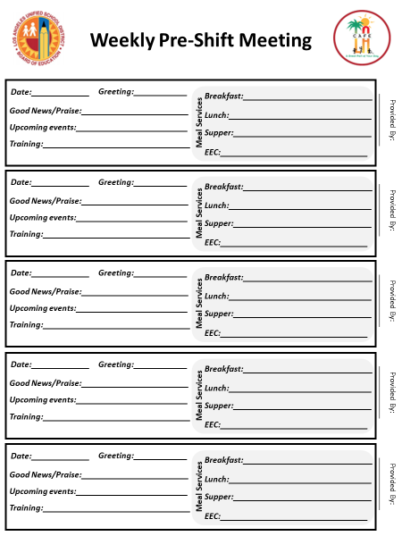
Pre-Shift Weekly Meeting Exercise
To assist with your creating the pre-shift, use the Weekly Pre-Shift sheet.
Fill out the corresponding lines with the information given to your specific group.
Work together and don’t forget to select a spokesperson for your group to present.
Notes:
TELL: There are four general areas in your pre-shift meetings that you should discuss during the course of the week; operations, forecasting, training and inspirations.
This is a great opportunity to discuss forecasting with any outliers for the day. You can discuss the day’s menu, what items need to be offered or taken to create a reimbursable meal, changes to the pricing if applicable, any item substitutions to the menu or take about the exciting new items on the menu. Correspond to your staff of any special events that could affect your operations, such as field trips, holiday, parties, and student testing. Also confer with them on how to precede their task for the day, thus creating teamwork for all. Training should be the primary focus of your pre-shift meetings. Use these minutes to reinforce training, review pertinent policies and procedures or reinforce safety measures.
It is just as important to uplift your employees with some inspiration, especially when the week has been challenging. Point out any positive actions that you and your staff have noticed. Keep your staff motivated and encourage them to stay positive. It is essential to end your meeting on a high note and share any positive happenings amongst the employees.

Slide 13
Questions?
Thank you!
LAUSD Food Services Division
Nourishing Children to Achieve Excellence
Notes:
TELL: Thank you for reviewing the training. Know that your staff will appreciate the time you take to communicate with your staff during the daily pre-shift meetings. Over time your staff will be more knowledgably about our meal programs and the overall operation. Knowledge is empowering.

Slide 14
Instructions On How To Complete The Weekly Pre-Shift Meeting
When preparing the day’s pre-shift message, review the previous day’s information, repeat any important messages from the previous days.
It is recommended to save the weekly pre-shift meeting sheet for the school year and discard on the last day.
If you need to review this information for review the pre-shift meeting information is available.

Slide 15
What Is Discussed In A Pre-Shift Meeting?
A pre-shift meeting entails pertinent information staff members need to know for a successful operational day.
Promotes Consistency
Daily operational goals
Relay important updates
Creates Teamwork
Coach and train staff
Motivates Employees
Provide positive feedback
Get the team excited for the upcoming shift
When preparing the day’s pre-shift message, review the previous day’s information, repeat any important messages from the previous days.

Slide 16
Filing And Record Retention
Save and file all Weekly Pre-Shift Meeting Forms for the durations of the school year. The file can be discarded on the last day of school.
Refer to prior pre-shift meetings for inspiration and ideas of information that may need to be repeated.
This form does not follow the filing and record retention guidelines, as these the forms will not be required for auditing purposes.

Slide 17
Instructions On How To Complete The Weekly Pre-Shift Meeting
A pre-shift meeting occurs before meal service, where the manager on duty huddles up their team to communicate the days goals, relay important updates, coach them and give advice, and get the team excited for the upcoming shift. When preparing the day’s pre-shift message, review the previous day’s information, repeat any important messages from the previous days.
Date: Insert today’s date
Greeting: Use a welcome phrase to start off the day like “Hello.” Or be creative such as; Marvelous Monday, Happy Taco Tuesday, etc.
Good News/Praise: Acknowledge individuals for their hard work, doing a good job, helping another employee, and/or the team being recognized for their work.
Upcoming events: Include any special or upcoming events such as holidays, early dismissal, field trips, spirit day(s).
Training: Inform training due dates, monthly training(s), For The Health Of It Wellness News.
Meal Services Section
Breakfast: Include any substitutions, changes, increase or decrease to meal counts; include N/A if no service or information needed.
Lunch: Substitutions, additional items, changes, participation counts; include N/A if there are no changes to service or information needed.
Supper: Substitutions, additional items, changes, participation counts; include N/A if there are no service changes or information needed.
EEC: Substitutions, additional items, changes, participation counts; include N/A if there are no service changes or information needed.
Provide by: Indicate the name of the person delivering the pre-shift meeting. The manager can designate other team members to deliver the pre-shift meeting.

Slide 18
Completing The Weekly Pre-Shift Meeting
Date: Insert today’s date
Greeting: Use a welcome phrase to start off the day like “Hello.” Or be creative such as; Marvelous Monday, Happy Taco Tuesday, etc.
Good News/Praise: Acknowledge individuals for their hard work, doing a good job, helping another employee, and/or the team being recognized for their work.
Upcoming events: Include any special or upcoming events such as holidays, early dismissal, field trips, spirit day(s).
Training: Inform training due dates, monthly training(s), For The Health Of It Wellness News.
6/23/2022
Marvelous Monday
Thanks, Teresa for staying extra yesterday to help shift
Tues. is Spirit Day; wear school colors
MyPLN training completion due 6/24/22

